Slide 1
How to record your presentation
We acknowledge our partners, sponsors and exhibitors

Slide 2
How to record your presentation
Two possible solution to manage this task
PowerPoPowerPoint TM from Microsoft®
Next slides will explain you as to process
Open source software as « OBS studio » software (https://obsproject.com/download) or « Captura » software (https://mathewsachin.github.io/Captura/). With these software you can directly add your webcam (optional)

Slide 3
How to record your presentation
Your video should meet the following criteria :
Duration : 12 minutes max
Size : 1 Go max
Resolution : Full HD (1920 x 1080 px minimum)
Format : MP4
Licensing : Please add a CC licence directly to your presentation. One sentence is sufficient, e.g.: Presentation “TITLE” by Author is licensed under CC BY-NC-ND 4.0.
Choose your licence here: https://chooser-beta.creativecommons.org/

Slide 4
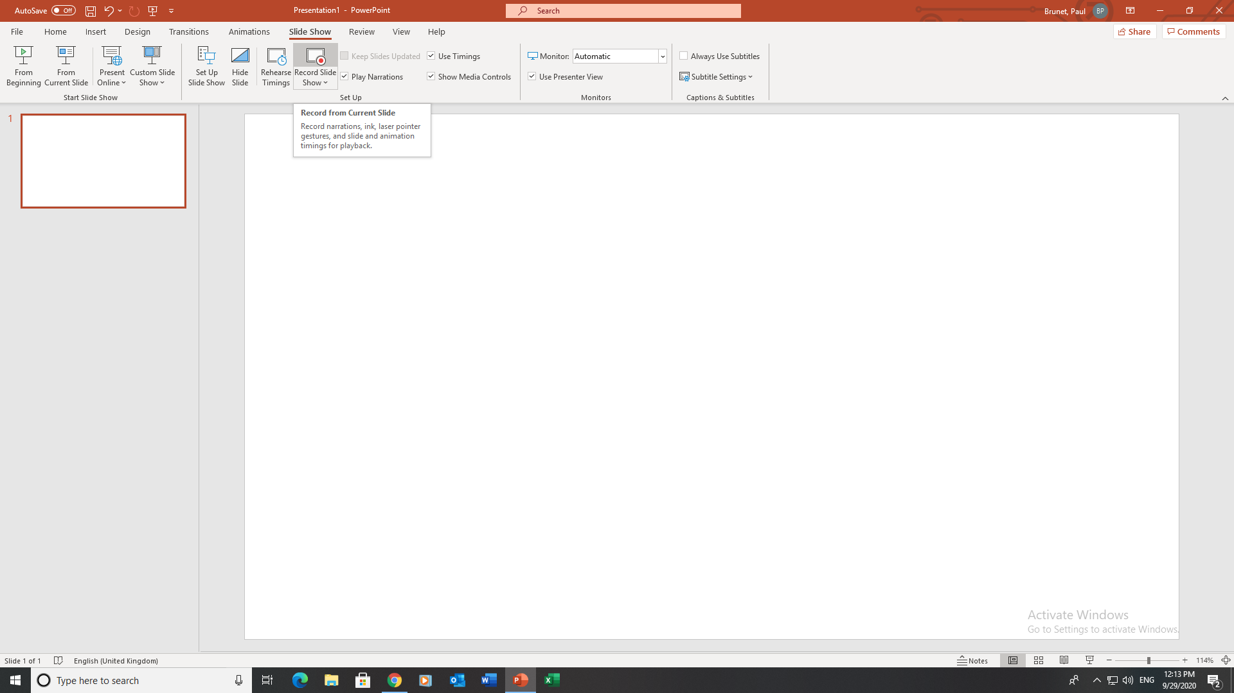
How to record your presentation
1. Create and save your presentation with PowerPoint TM from Microsoft®

Slide 5
How to record your presentation
Open your presentation to record it with PowerPoint TM
from Microsoft®> “slide show”

Slide 6
How to record your presentation
3. Record your presentation using « record slide show»

Slide 7
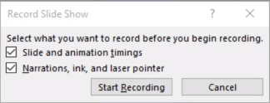
How to record your presentation
3. Record your presentation using « record slide show»

Slide 8
How to record your presentation
4. Record your presentation
Your Presentation

Slide 9
How to record your presentation
5. Export in video format
File > Export > Create a video

Slide 10
How to record your presentation
5. Export in video format with PowerPoint TM from Microsoft®
File > Export > Create a video
Select video quality in first dropdown menu Full HD (1920 x 1080 px minimum) – MP4
Add your recorded times and text in second dropdown menu
Create Video

